Slide 1


General Biology lab
Al-Karkh University for Science
Collage of Science
Microbiology Department
Dr. Rawa Abdul Redha Aziz
Ph.D Antibiotics/ Molecular biology
Laboratory Staff:
1. Lecturer Dr. Rawa Abdul Redha Aziz
2. L. assistant Sura Alaa Saud
3. L. assistant Gada Readh
Supervised by:
1. Prof. Munira Ch. Ismaeel
2. Ass. Prof. Israa AJ Ibrahim

Slide 2
Lab 7: Isolation of bacteria from environment

Slide 3
Bacteria in the atmosphere
Throughout this lab manual, proper sterile technique has been repeatedly stressed because of the possibility of contamination by airborne and other microorganisms. In this exercise, we will attempt to isolate and characterize a few airborne microorganisms.
Materials
Each student/team:
4 Nutrient agar plates.
Gram stains materials.
Procedure
1. Choose four locations from which bacteria will be sampled. These may be different rooms, locations within one room, or even outside of the building.
2. Label the plates with the sample location as well as students' names, dates, etc.
3. Put an open plate of each type at each location. Leave it there for 30 minutes.
4. Cover the nutrient agar plates with laboratory film (Parafilm) and incubate them for 24-48 hours at 37°C.
5. The laboratory film prevents the agar from drying out during the long incubation time.
6. After incubation, perform a Gram stain for at least one isolated colony from each nutrient agar plate. Also note the number and types of colonies on each plate.

Slide 4
**We can also sample different places and culture them on nutrient agar or nutrient broth like:
Sink, 2. Skin, 3.Teeth, 4. Bathroom floor, 5. Cosmetic staff, and under nails…….
As the following procedure:
Use sterilized disposable swab and make it wet with distilled water in order to take the sample from any of the above sources.
Streak the swab onto nutrient agar plates (N.A). Repeat the step for each sample.
Incubate N. A. plates at 37°C for 24 hours.
After incubation period, culture the resulting bacteria onto another N.A. plate to get isolated colony.
Use gram stain technique to identify the genus.

Slide 5
Figure 1: Basic colony morphology types

Slide 6
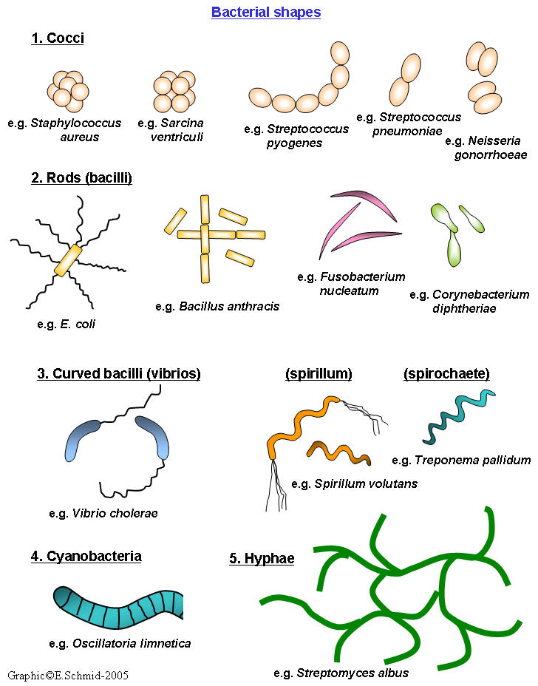
Figure 2 a: Bacterial Shape

Slide 7
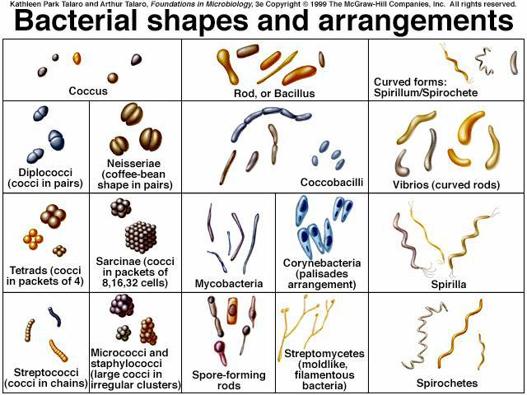
Figure 2 b: Bacterial Shape

